Slide 1
Hierarchical Decision Making by Generating and
Following Natural Language Instructions
Hengyuan Hu Denis Yarats Qucheng Gong
Yuandong Tian Mike Lewis
Presented By:
Fatema Islam Meem
ID: 17301011

Slide 2
Introduction
Many complex problems can be naturally decomposed into steps of high level planning and low level control.
Manually specifying macro-actions requires significant domain expertise, limiting generality and scalability.
In this paper, agent first generates a plan for hierarchical decision making in natural language, which is then executed by a separate model.
A dataset of 76 thousand pairs of instructions and executions from a real-time strategy game is used to train instructor and executor models.

Slide 3
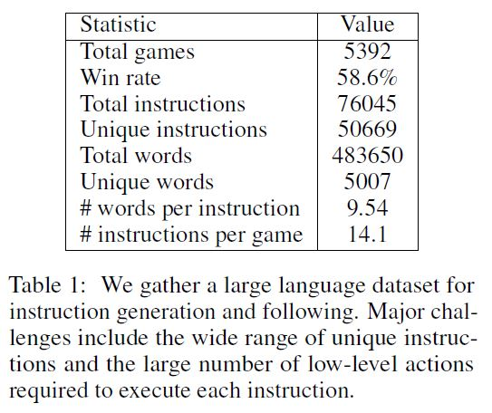
Task Environment & Dataset
Task Environment: A new Real-Time Strategy (RTS) game environment is introduced. It has a set of 7 unit types, designed with a rock-paper-scissors dynamic such that each has some units it is effective against and vulnerable to.
Dataset: A dataset of two humans playing collaboratively against a rule-based opponent is used. Both players have access to the same information about the game state, but have different roles.

Slide 4
Model
The model is divided into two parts. An executor model maps instructions and the game states into unit-level actions of the environment, and an instructor model generates language instructions given the game states. Both models is trained with human supervision.
Game Observation Encoder
Spatial Inputs Encoder
Non-spatial Inputs Encoder

Slide 5
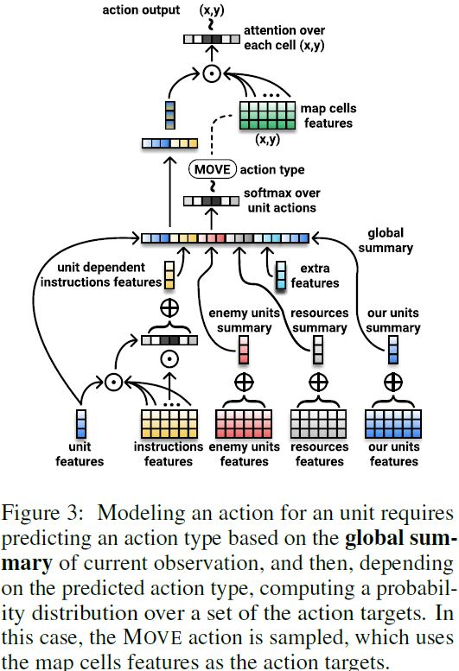
Executor-Instructor Model & Experiments
Executor Model: The executor predicts an action for every unit controlled by the agent based on the global summary of the current observation.
Instructor Model: The instructor maps the game state to instructions. It uses the game observation encoder to compute a global summary and current instruction embedding similar to the executor.

Slide 6

Training
Since one game may last for tens of thousands of frames, it is not feasible nor necessary to use all frames for training. Instead, one frame is taken every K frames to form the supervised learning dataset.
Executor Model: The executor is trained to minimize the following negative log-likelihood loss:
where s represents game state and instruction, Pcont(js) is the executor GLOBAL CONTINUE classifier, c is a binary label that is 1 if all units should continue their previous action, P_{A}(a_{ui} | s) is the likelihood of unit i doing the correct action a_{ui} .
Instructor Model: The loss for the instructor model is the sum of a loss for deciding whether to issue a new instruction, and the loss for issuing the correct instruction:

Slide 7
Conclusion
Here, work should use reinforcement learning to further improve the planning and execution models, and explore generating novel instructions.

Slide 8


